Slide 1
Paragraph Structure, unity and coherence

Slide 2
Goals
Learn to write a well-structured paragraph
Learn to write a good paragraph with unity and coherence

Slide 3
Agenda
Paragraph structure (completeness and clarity)
Unity and coherence
Peer review
Sharing
Homework

Slide 4
paragraph
What is a paragraph? Could you try defining it?
A paragraph is a group of related sentences that discuss one (and usually only one) main idea.
How long/short can a paragraph be?

Slide 5
paragraph
What does a typical paragraph consist of?
A topic sentence
Topic + Controlling idea
A complete sentence
Position in a paragraph
Supporting sentences
Specific and factual (examples, statistics quotations)
A concluding sentence (optional)
Summary of main points OR restatement of the topic sentence in different words

Slide 6
paragraph
Purpose of the Topic Sentence
A topic sentence essentially tells readers what the rest of the paragraph is about.

Slide 7
paragraph
Topic Sentences and Controlling Ideas
Every topic sentence will have a topic and a controlling idea. The controlling idea shows the direction the paragraph will take.

Slide 8
Here are some examples:
1. There are many reasons why pollution in ABC Town is the worst in the world.
2. To be an effective CEO requires certain characteristics.
3. There are many possible contributing factors to global warming.
4. Fortune hunters encounter many difficulties when exploring a shipwreck.
5. Dogs make wonderful pets because they help you to live longer.
6. Crime in poverty-stricken areas occurs as a result of a systemic discrimination.

Slide 9
Why is a topic sentence important?
First, it helps you, the author, to stay focused;
Second, a clearly stated topic and controlling idea will give readers the tools they need to clearly understand what you have to say.
Remember that topic sentences set the tone for the paragraph and should relate back to the thesis or the main idea of the paper.

Slide 10
How to compose a good topic sentence
1. State your main idea clearly.
— It must include the topic and an opinion.
2. Balance the topic sentence between specifics and general ideas.
— Don't write too vague or general.
Don't write too narrow of a statement.
3. Hook your reader.
— One of the many important roles of a topic sentence is to draw the readers in.
4. Keep it short and sweet.
5. Give a reasonable opinion.
6. Use the topic sentence as a transition.
— Think of this sentence as a “bridge” between the main idea of the previous paragraph and the main idea of this next paragraph.

Slide 11
unity
How many ideas are discussed in a paragraph?
One and only one idea
Sometimes more than one aspect of the same idea
Do the supporting sentences directly explain/prove the main idea?

Slide 12
unity
A paragraph has unity when all the sentences support a single idea.
The paragraph must have one controlling idea in the topic sentence. Otherwise the paragraph loses focus.
The supporting sentences must support or explain the controlling idea with examples, details, steps, or definitions. Otherwise, the paragraph will not be about one single idea.
The concluding sentence should restate the idea in the topic sentence . Otherwise the main idea might not be clear.

Slide 13
unity
I live in a flat with my family. We have two bedrooms and a living room. We have a garden and we have some flowers there. In weekdays I arrive home at five o'clock and I have lunch. Then I do my homework and go to bed. I had a computer but now it doesn't work. I have a brother and a sister and I think I am very lucky to live with them. Sometimes our relatives visit us. Our flat becomes very crowded sometimes but I like it.

Slide 14
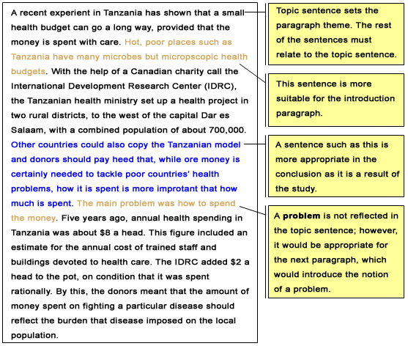
unity

Slide 15
coherence
Maintaining coherence in a paragraph or
composition not only requires unity, but also a
logical, smooth, and natural flow from one idea
to another. When this occurs, coherence has
been established.

Slide 16
key ways to create coherence in a paragraph
Repeat key
A tip: use synonyms or expressions with the same meaning
Use consistent pronouns
A tip: don’t change from you to he/she or from he/she to they

Slide 17
key ways to create coherence in a paragraph
Use transition signals to link ideas
In an effective composition, the current of thought flows smoothly throughout the composition. Use one or more types of transitional words or phrases to connect ideas within and between paragraphs:
(1) transitional expressions
(2) direct pronoun references
(3) repetition of key words

Slide 18
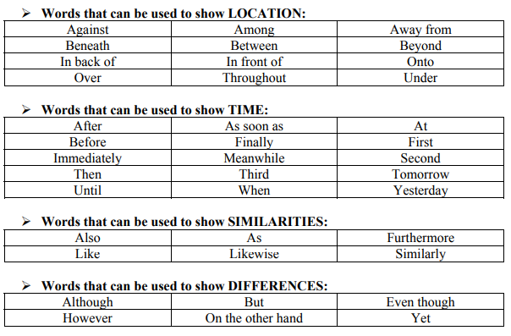
Typical Transition signals

Slide 19
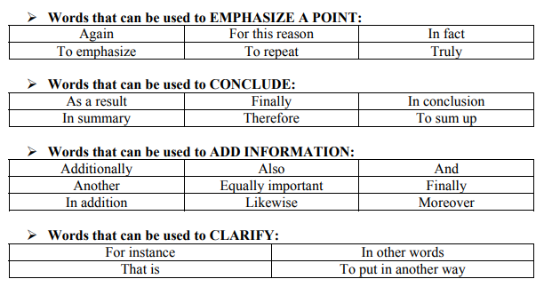
Typical Transition signals

Slide 20
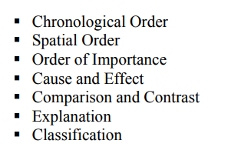
key ways to create coherence in a paragraph
Arrange ideas to achieve coherence
— Body paragraphs should be well developed and arranged in a logical order. Use a pattern of organization that is appropriate to the composition purpose and the audience.


Slide 21
key ways to create coherence in a paragraph
 1. Chronological Order:
- Narrating a story 
- Explaining a step-by-step process 
- Relating a historical account 
- Relating an incident or anecdote
2. Spatial Order
- Describing a scene or place
3. Order of Importance
- Presenting facts, examples, reasons 
- Writing persuasively  Evaluating a subject


Slide 22
key ways to create coherence in a paragraph
 4.  Cause and Effect
- Explaining scientific findings 
- Explaining a historical event
5. Classification
- Analyzing literature, a speech, etc. 
- Defining a subject


Slide 23
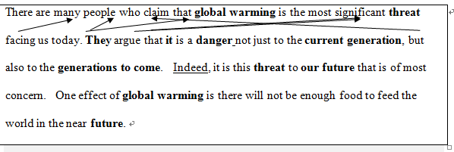
Model paragraph
Make sure that each sentence starts with a reference back to the previous sentence.

Slide 24
I live in a house in Izmit. It isn't old or modern. It's a normal Turkish house. We can say it is near the sea. It takes about 10 minutes to go to the seaside on foot. We have one bedroom, one living room. We also have two other rooms, too. We use them as a dining room. Naturally, we have a kitchen, a bathroom, and a toilet. I live with my parents. And our house has a little garden; my parents spend their time there to grow vegetables and fruit.

Slide 25
(1) The human body is a wonderful piece of work that nature has created. (2) It is not beautiful like the body of a butterfly or peacock but it is shaped practically. (3) It can do many types of work which other animals cannot. (4) It is not strong like the body of a tiger. (5) But in place of physical strength it has a big and sharp brain. (6) By using this brain the human physique has been able to overcome many of its limitations. (7) By sitting in an aeroplane it flies faster than a kite, by riding a motorcycle it travels faster than a leopard, and by firing a machine gun it fights much better than a tiger. (8)In spite of all this, the human body suffers from many diseases because it has a weakness for habits such as smoking, drinking and overeating. (9) When it is healthy the body can give great pleasure but when it is sick it can cause great pain. (10) The wise man would always keep his body fit because a healthy mind can work only in a healthy body.

Slide 26
The first sentence states the main idea of the paragraph and claims the superiority of the human body over the rest of the creation. It enables the reader to expect the following ideas in the paragraph that explain and illustrate the qualities and attributes of the human body.
The second, third, fourth, fifth, sixth, and seventh sentences compare, contrast, elucidate and justify the main idea or topic sentence. They establish the main theme with logical explanations and transitions. They create a graphic picture in the minds of the reader with suitable and appropriate language expressions. In brief, they develop the main idea of the paragraph.
The eighth and the ninth sentences interpret and analyze the limitations of the human body and prove the strength of the topic sentence. They, further, lead the main idea into a concluding thought.
Finally, the tenth sentence concludes with the idea that the human body should be well preserved for a proper functioning of the system and that a healthy mind can work only in a healthy body.
Thus the paragraph, The Human Body, is a unified and coherent paragraph.

Slide 27
abstract of a journal paper
What does an abstract usually contain?
What you study is about
Your major results
Major contributions/implications
Are citations or formulae necessary?
More often than not, the abstract does not require citations; some journals discourage use of mathematical symbols.

Slide 28
Fishes swim by flapping their tail and other fins. Other sea creatures, such as squid (乌贼) and salps (樽海鞘), eject (喷射) fluid (液体) intermittently (间歇地) as a jet. We discuss the fluid mechanics behind these propulsion mechanisms (推进机制) and show that these animals produce optimal vortex (涡流) rings, which give the maximum thrust for a given energy input. We show that fishes optimize both their steady swimming efficiency and their ability to accelerate and turn by producing an individual optimal ring with each flap of the tail or fin. Salps produce vortex rings directly by ejecting a volume of fluid through a rear orifice (孔口), and these are also optimal. An important implication of this paper is that the repetition of vortex production is not necessary for an individual vortex to have the optimal characteristics. (Linden & Turner 2004)

Slide 29
Fishes swim by flapping their tail and other fins. Other sea creatures, such as squid (乌贼) and salps (樽海鞘), eject (喷射) fluid (液体) intermittently (间歇地) as a jet. We discuss the fluid mechanics behind these propulsion mechanisms (推进机制) and show that these animals produce optimal vortex (涡流) rings, which give the maximum thrust for a given energy input. We show that fishes optimize both their steady swimming efficiency and their ability to accelerate and turn by producing an individual optimal ring with each flap of the tail or fin. Salps produce vortex rings directly by ejecting a volume of fluid through a rear orifice (孔口), and these are also optimal. An important implication of this paper is that the repetition of vortex production is not necessary for an individual vortex to have the optimal characteristics. (Linden & Turner 2004)

Slide 30
Typical Transition signals
A few things:
#1: Firstly, secondly vs. First, Second
#2: On one hand… on the other hand vs.
On the one hand… on the other hand

Slide 31
Typical Transition signals continued
#3: Last but not the least vs. Last but not least
#4: Important vs. importantly
The former is often used with more or most; the latter is more flexible and not requiring more or most. https://www.merriam-webster.com/
…; second and most important, the book contains no woman character.
...; importantly, we have to finish it before 30th May.

Slide 32
Unity Checklist
Does every detail I have selected support the main idea?
Have I organized the supporting details in the most logical way?
Have I included any sentences that are unnecessary because they simply Restate the main point without adding any new information or meaning?
Have I made the relationships between my ideas clear?

Slide 33
PEER REVIEW
Topic sentence
If you have to delete one sentence from your abstract or essay, which one will you delete? What is the reason?
Possible reasons:
It does not support the main topic.
It is not related to other sentences.
It is neither relevant nor important.
No deletion. My abstract has unity and coherence!
Circle or highlight all transition signals in your abstract.
Discuss if the use of the transitional signals is appropriate.
Do not overuse!

Slide 34
Homework
You need to bring your draft and laptop/tablet to class in Weeks 6-7.

